Slide 1
STUDENT ALCOHOL CONSUMPTION
Prepared by: [SARTHAK GUPTA]

Slide 2
Introduction
Objective
The goal of this project was to calculate the alcohol consumption by the student during weekends and weekdays using grades ,demographic and social features.

Slide 3
RELATED WORKS
The past work intended to calculate the grades and academic excellence of the students in secondary education using data mining models in three different period(G1,G2,G3).

Slide 4
DATASET USED
The source of Dataset was:
http://archive.ics.uci.edu/ml/datasets/student+performance
The dataset has been collected from two Portuguese schools.
The dataset provides the performance of students in two subjects :
Mathematics
Portuguese

Slide 5
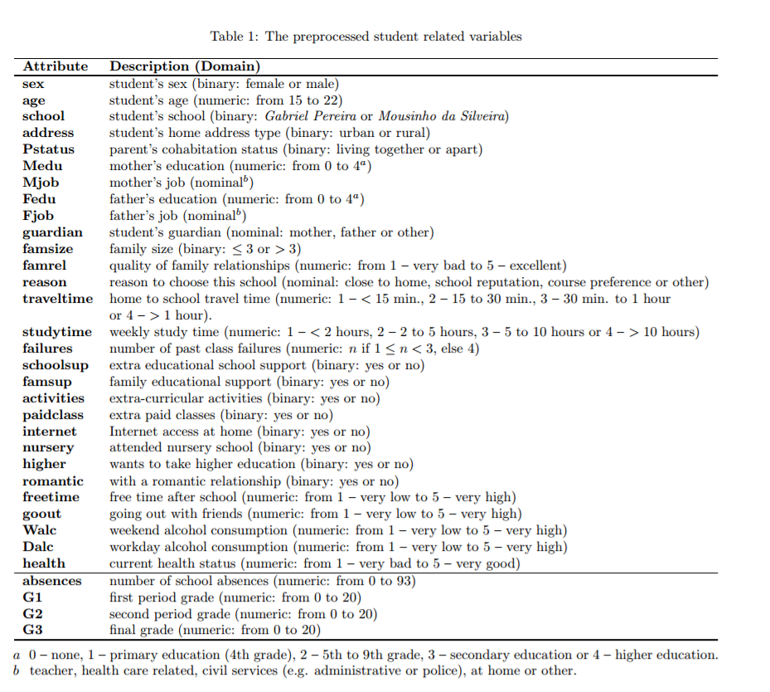
DATASET DESCRIPTION
The dataset contains number of demographic and social features:

Slide 6
PROJECT METHODOLOGY
Analysis and Pre-processing of Data
Classifying using Data Models
Comparing the Data Models
Finding the Accuracy

Slide 7
DATA MODELS USED
Logistic Regression
SVM
Decision Tree

Slide 8
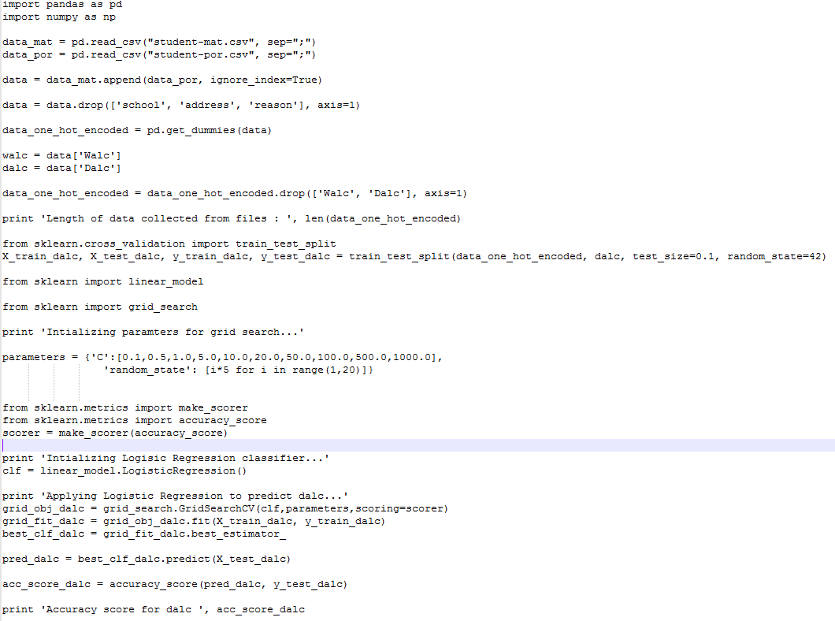
Code for Logistic Regression

Slide 9
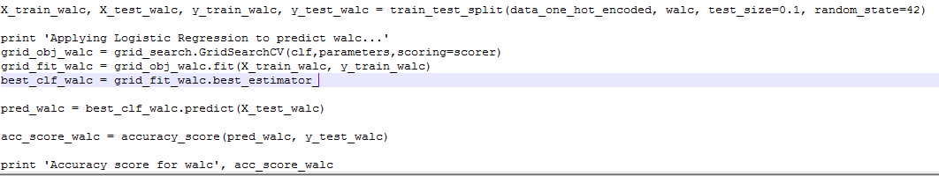
Contd.…..

Slide 10
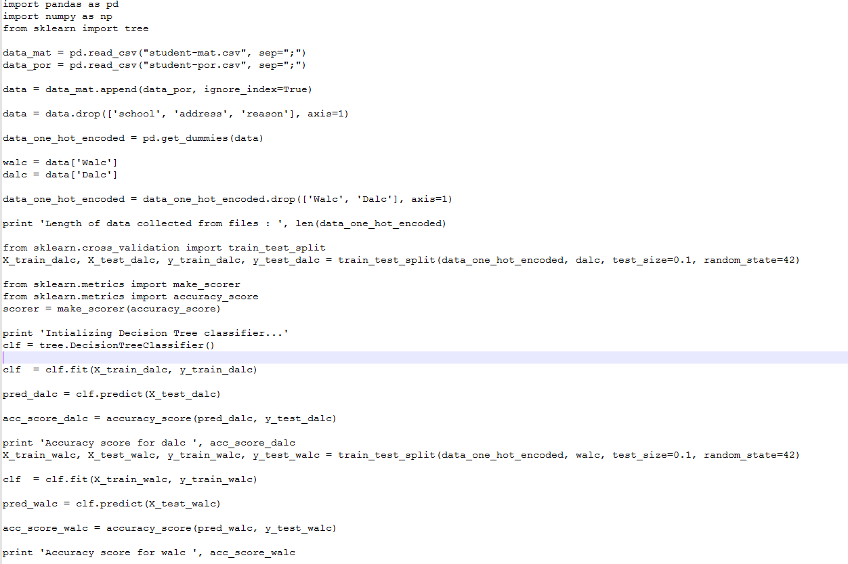
Code Snippets for Decision Tree

Slide 11
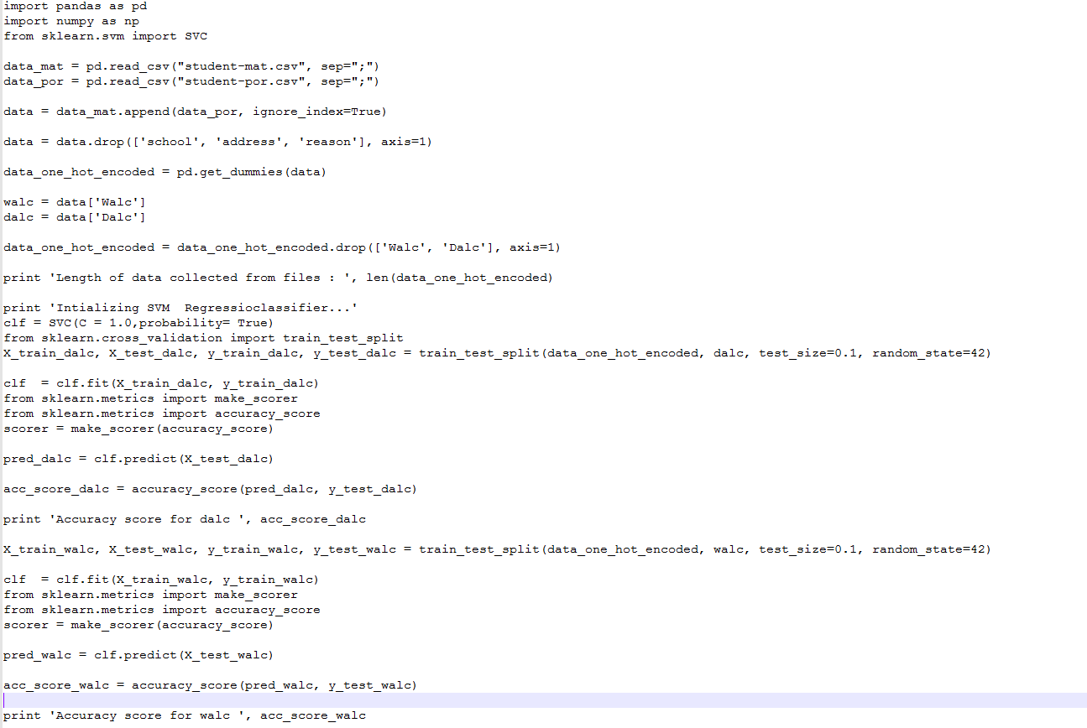
Code Snippets for SVM

Slide 12
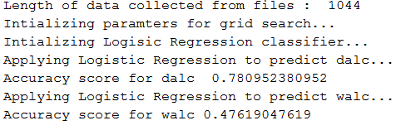
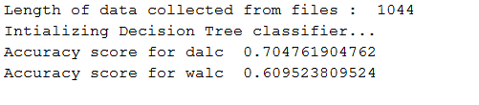
OUTPUT
Logistic Regression
Decision Tree

Slide 13
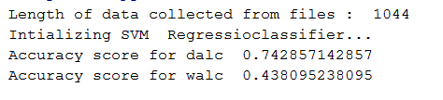
Contd….
SVM

Slide 14
Results:
Data Model | Accuracy for Dalc | Accuracy for Walc
Logistic Regression | 78% | 47%
SVM | 74% | 43%
Decision Tree | 70% | 61%

Slide 15
Conclusion
The accuracy for predicting Dalc(Daily Alcohol Consumption) is maximum for Logistic Regression followed by SVM and then Decision Tree.
The accuracy for predicting Walc(Weekend alcohol Consumption) is maximum for Decision Tree followed by Logistic Regression and then SVM.
The value of C = 0.1 and random state = 5 gives us the maximum accuracy.

Slide 16
REFERENCES
[1] P. Cortez and A. Silva. Using Data Mining to Predict Secondary School Student Performance. In A. Brito and J. Teixeira Eds., Proceedings of 5th FUture BUsiness TEChnology Conference (FUBUTEC 2008) pp. 5-12, Porto, Portugal, April, 2008, EUROSIS, ISBN 978-9077381-39-7.
[2]http://scikitlearn.org/stable/modules/generated/sklearn.linear_model.LogisticRegression.htm
[3]https://chrisalbon.com/machinelearning/cross_validation_parameter_tuning_grid_search.html

